Slide 1


QCD Closure Tests 2016, 2017, 2018
George Bakas, Ioannis Papakrivopoulos

Slide 2
Overview
Efficiencies and Acceptance for mTT and jetPt variables
Selection:
Jet Matching
Parton cuts:
partonPt[0],[1] > 400
|partonEta[0],[1]| < 2.4
mTTbarParton > 1000
Reco cuts:
nJets > 1
nLeptons = 0
mJJ > 1000
jetPt[0],[1] > 400
|jetEta[0],[1]| < 2.4
bTagging cut (mediugm WP deepCSV) (2016: 0.6321, 2017: 0.4941, 2018: 0.4184)
Tagger cut (top Tagger) (2016: 0.2, 2017:0.0, 2018: 0.1)
JetMassSoftDrop > 120 GeV and < 220 GeV
TriggerBit

Slide 3
Purpose of this presentation
The QCD closure tests show the shape comparison between 3 regions
Signal Region (SR): all cuts shown before + 2btagged jets
Control Region (CR): same cuts as SR but btag cut is reverted (0 btag jets)
1bTag region: same cuts as SR but only 1 jet needs to be btagged
Control Region Contamination: Shows the percentage of the ttbar signal that passes the Control region cuts
For each year, different topTagger cut Working points + btag WP’s
QCD Closure Tests + ttbar CR contamination for variables:
mJJ: [1000, 1200, 1400, 1600, 1800, 2000, 2400, 2800, 3200, 4000, 5000]
ptJJ: [0,60,150,300,450,600,750,950,1100,1300]
yJJ: [-2.4,-1.5,-1.0,-0.5,0.0,0.5,1.0,1.5,2.4]
Leading and subleading jetPt: [400,450,500,570,650,750,850,950,1100,1300,1500]
Leading and subleading |jetY|: [0.0,0.2,0.4,0.6,0.8,1.0,1.2,1.4,1.6,1.8,2.0,2.2,2.4]

Slide 4
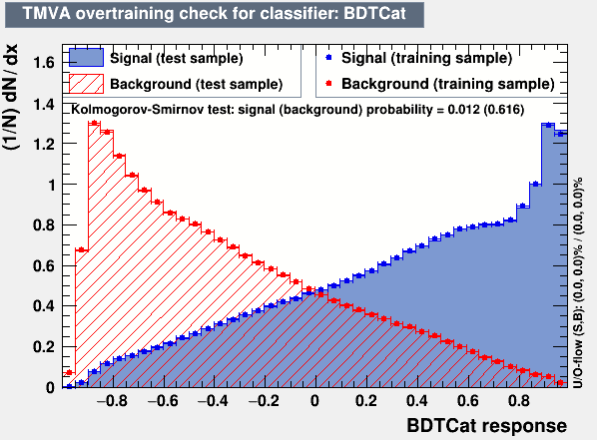
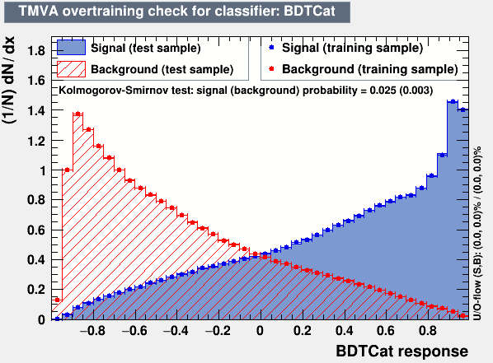
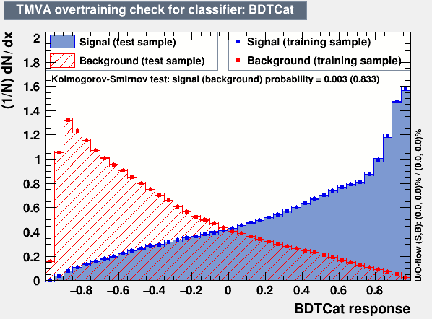
Training Outputs
2016
2017
2018

Slide 5
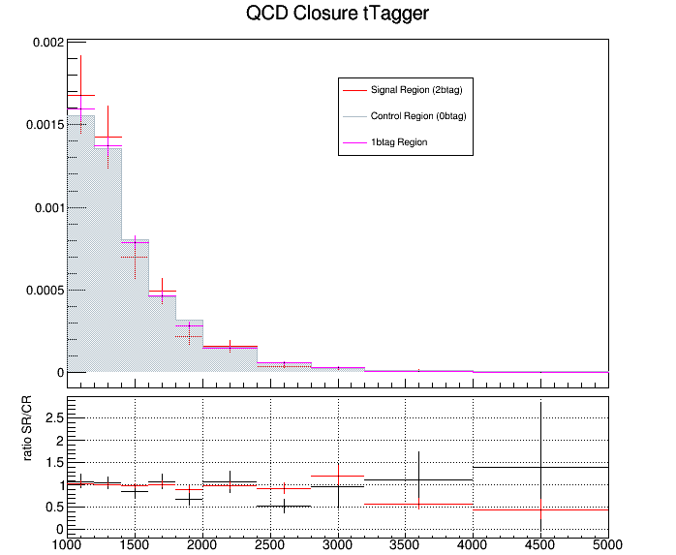
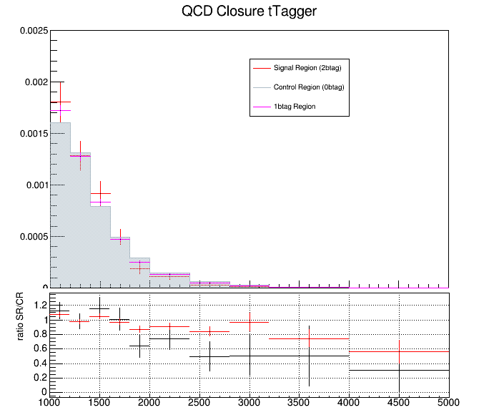
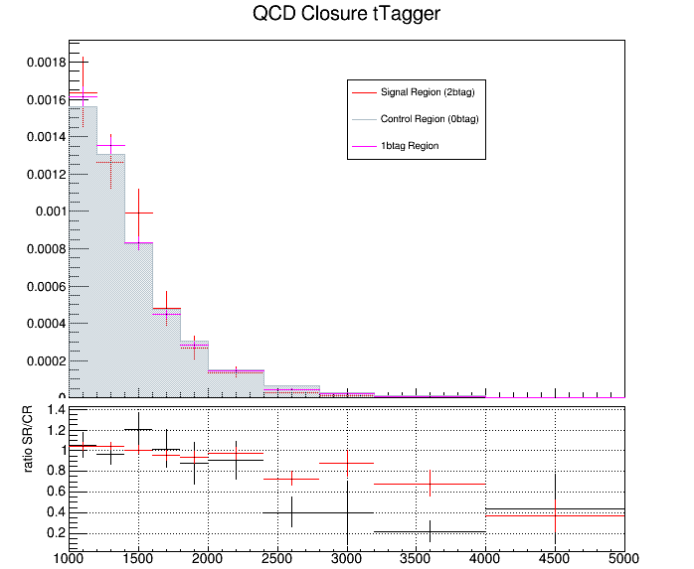
QCD Closure Tests ’16, ‘17, ’18 mJJ
2016
2017
2018
mJJ(GeV)
mJJ(GeV)
mJJ(GeV)

Slide 6
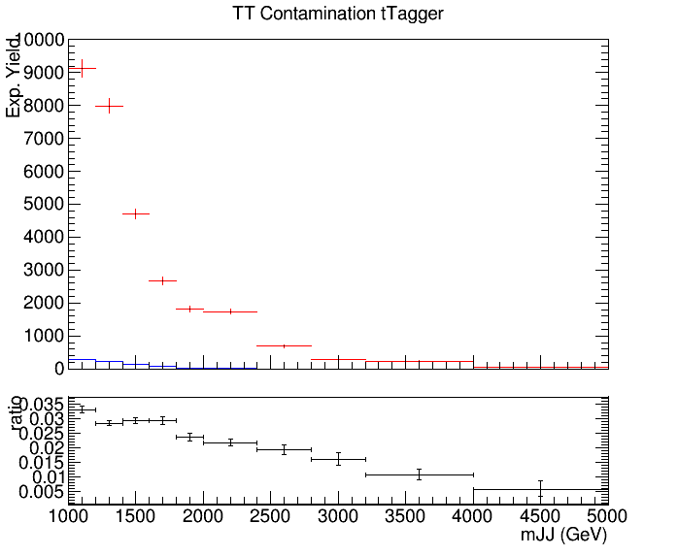
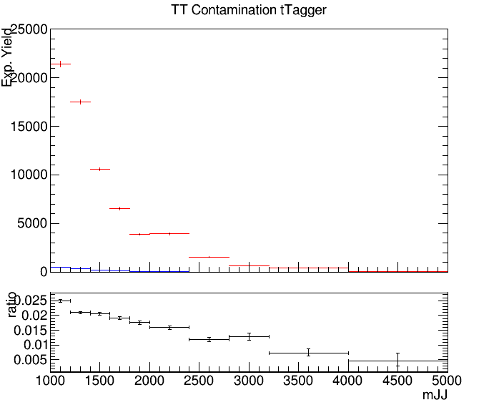
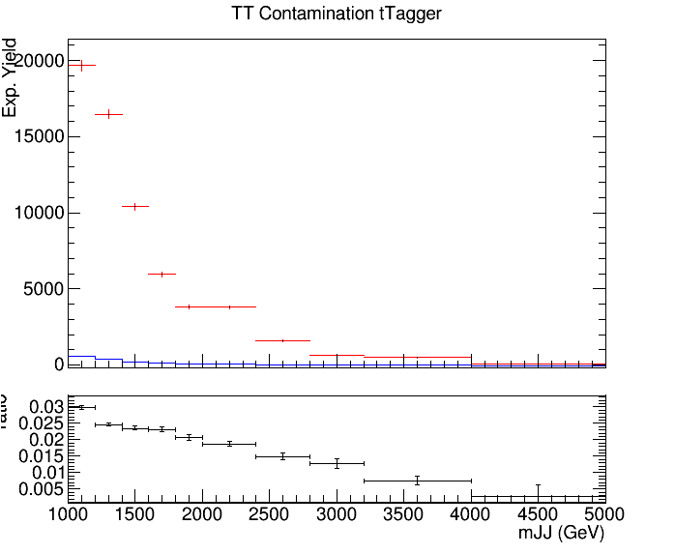
CR Contamination ‘16,’17,’18 mJJ
Control Region QCD sample
Control Region TT sample
2016
2017
2018

Slide 7
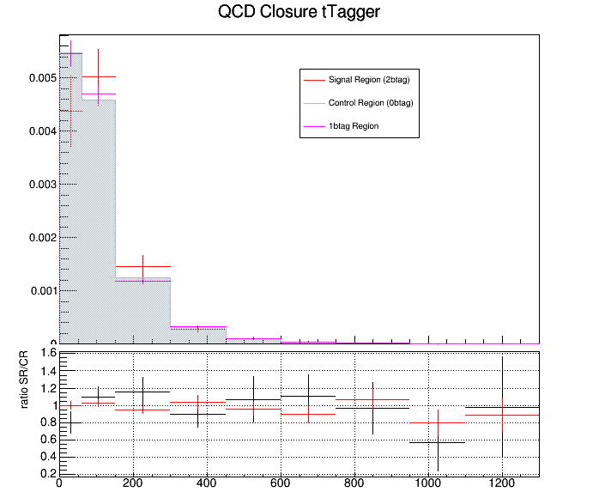
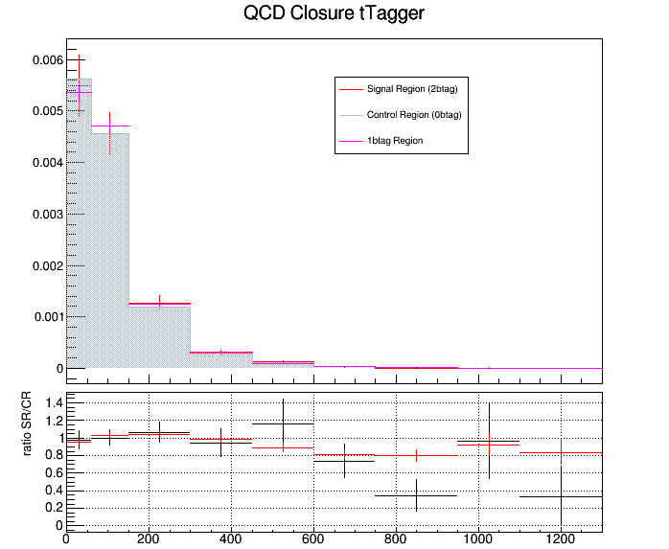
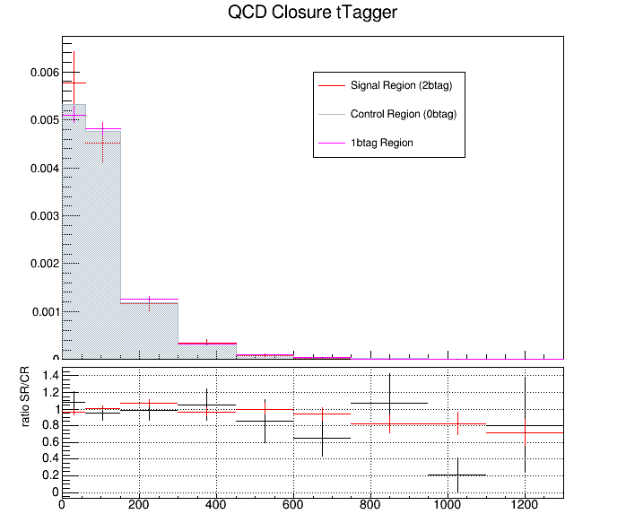
QCD Closure Tests ’16, ‘17, ’18 ptJJ
2016
2017
2018
ptJJ(GeV)
ptJJ(GeV)
ptJJ(GeV)

Slide 8
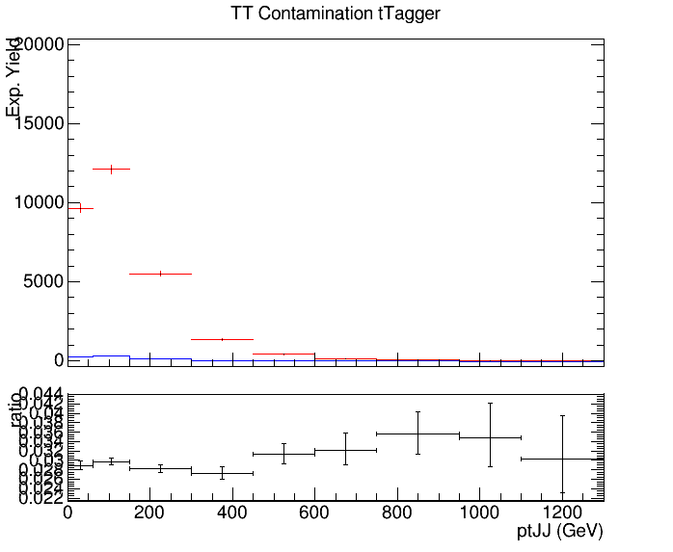
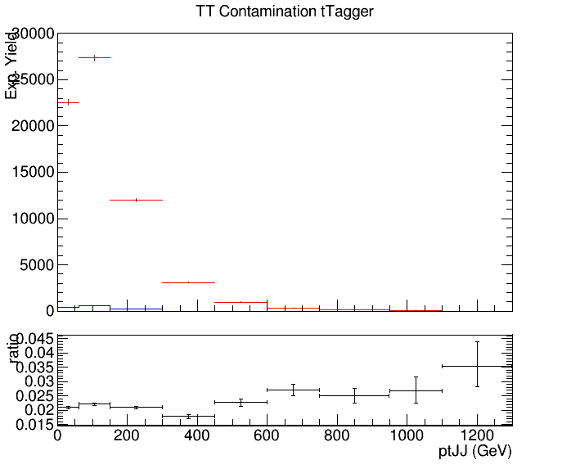
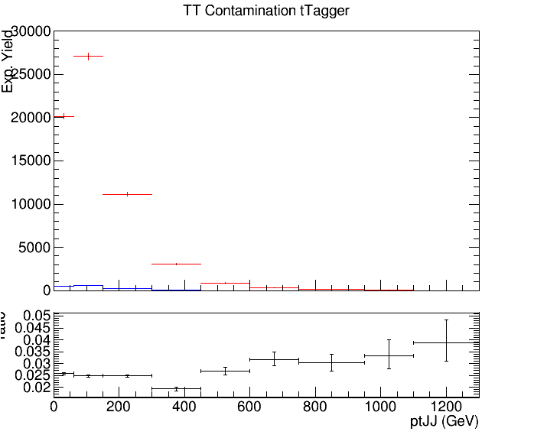
CR Contamination ‘16,’17,’18 ptJJ
Control Region QCD sample
Control Region TT sample
2016
2017
2018

Slide 9
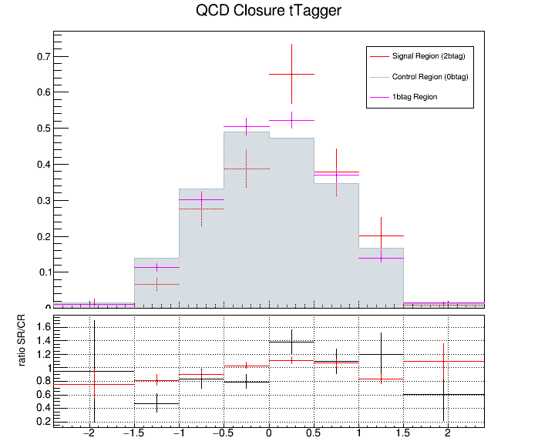
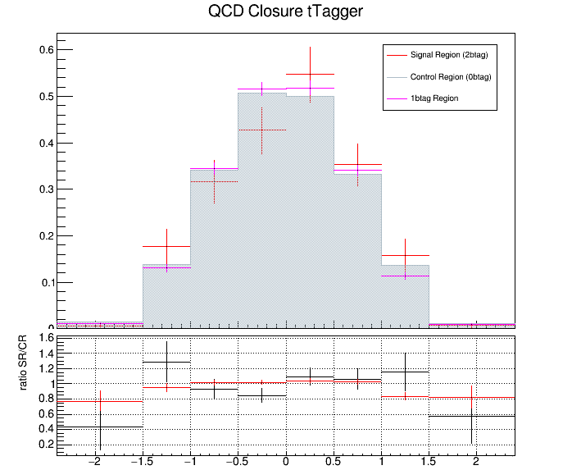
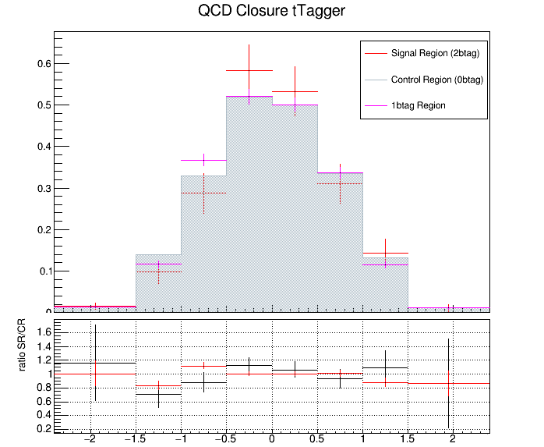
QCD Closure Tests ’16, ‘17, ’18 yJJ
2016
2017
2018
yJJ
yJJ
yJJ

Slide 10
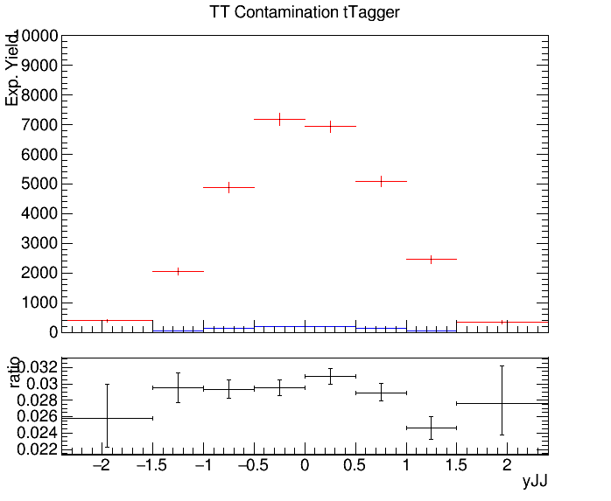
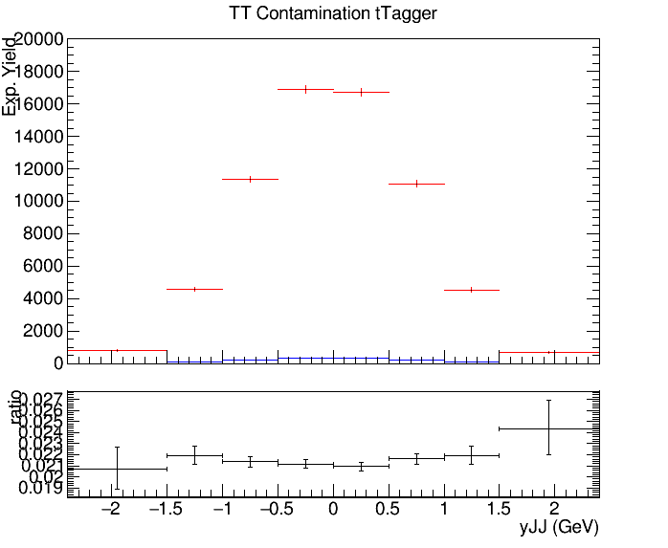
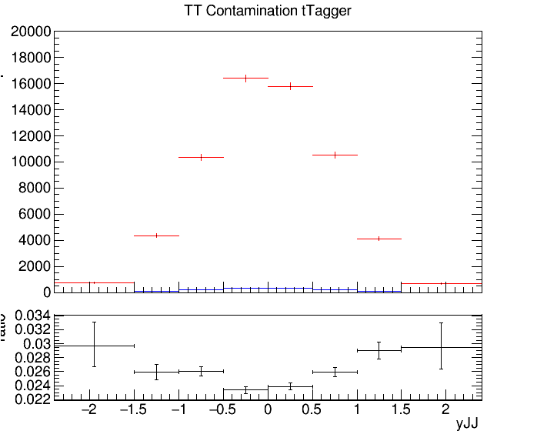
CR Contamination ’16,’17,’18 yJJ
Control Region QCD sample
Control Region TT sample
2016
2017
2018

Slide 11
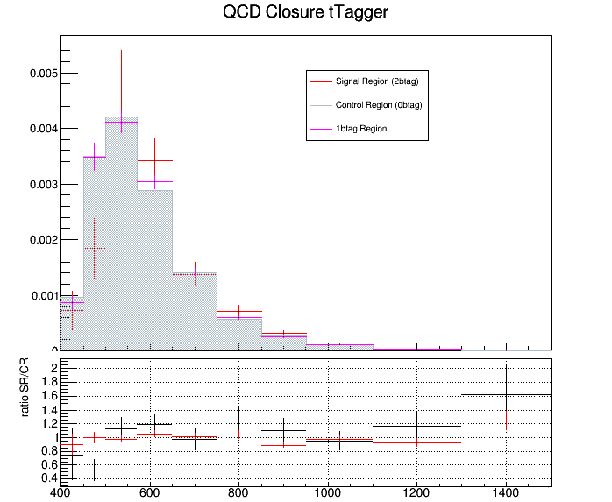
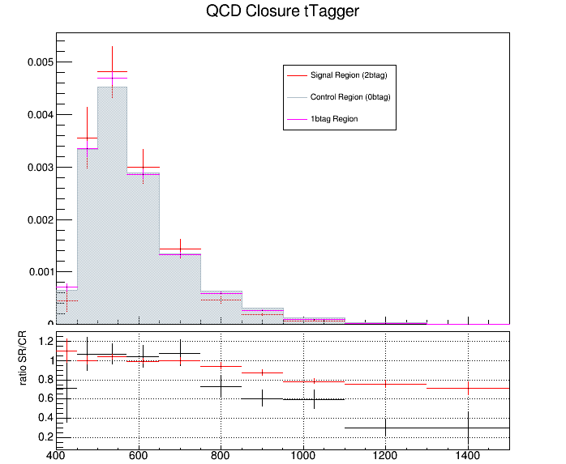
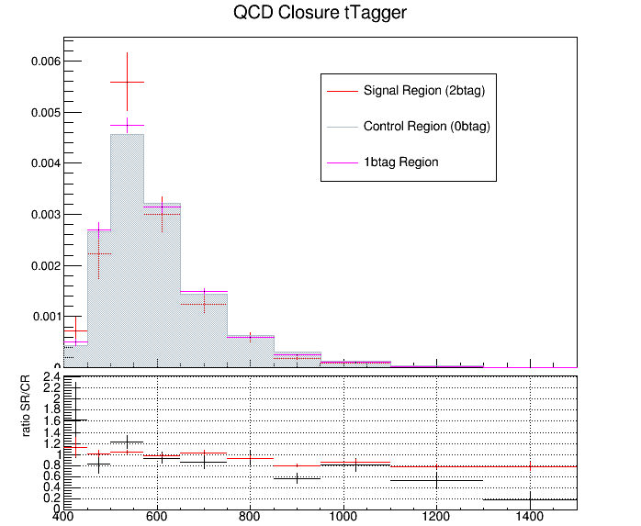
QCD Closure Tests ’16, ‘17, ’18 jetPt0
2016
2017
2018
jetPt0 (GeV)
jetPt0 (GeV)
jetPt0 (GeV)

Slide 12
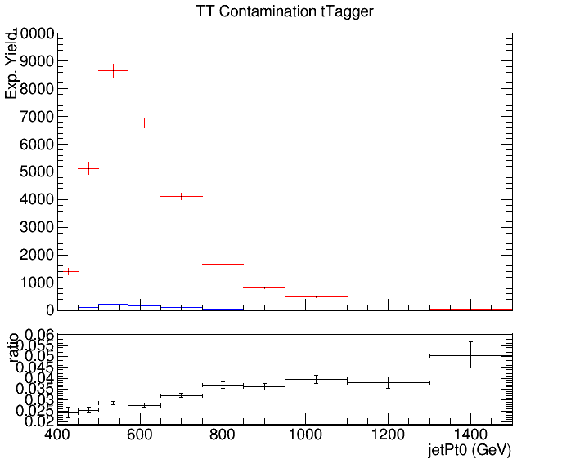
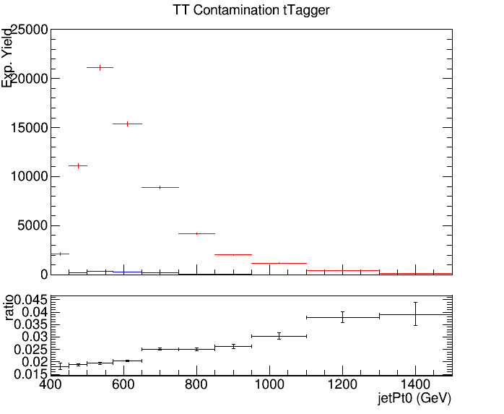
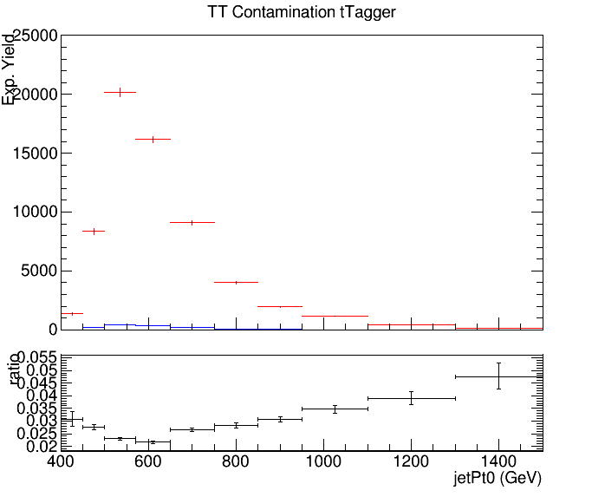
CR Contamination ’16,’17,’18 jetPt0
Control Region QCD sample
Control Region TT sample
2016
2017
2018

Slide 13
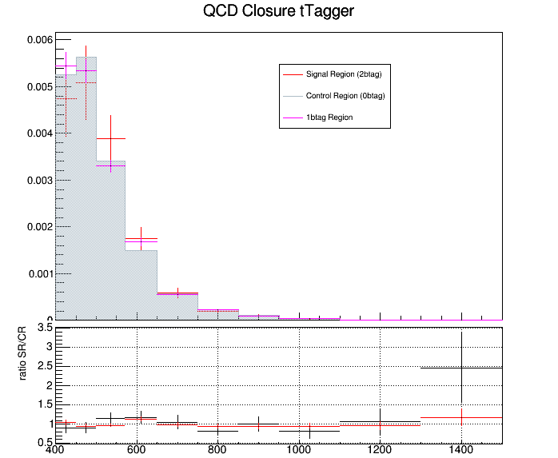
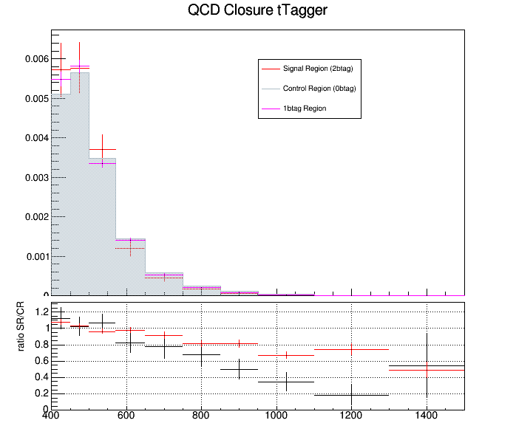
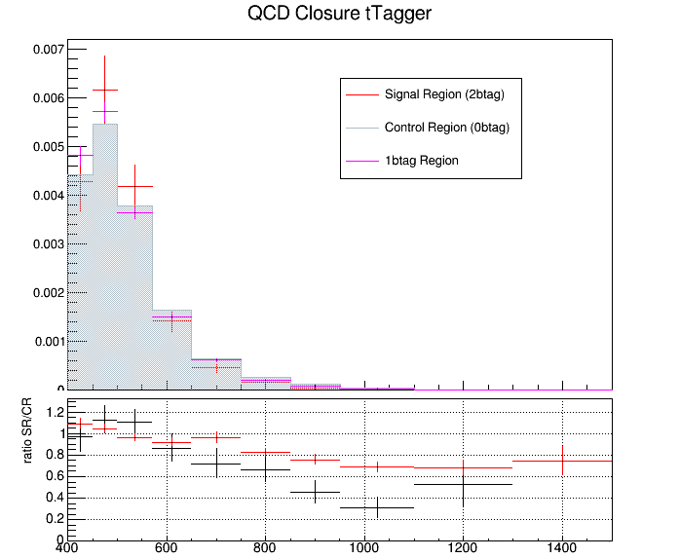
QCD Closure Tests ’16, ‘17, ’18 jetPt1
2016
2017
2018
jetPt1 (GeV)
jetPt1 (GeV)
jetPt1 (GeV)

Slide 14
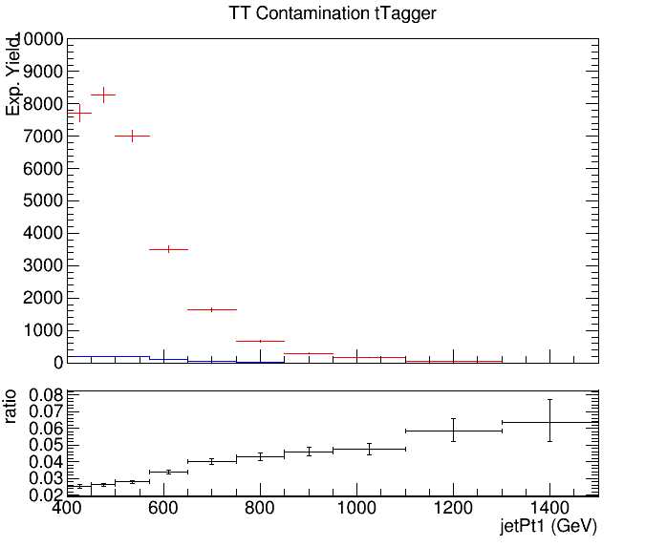
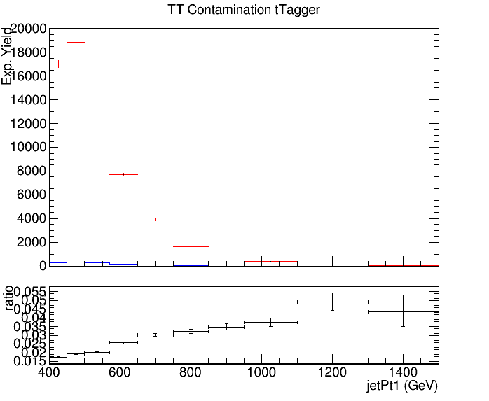
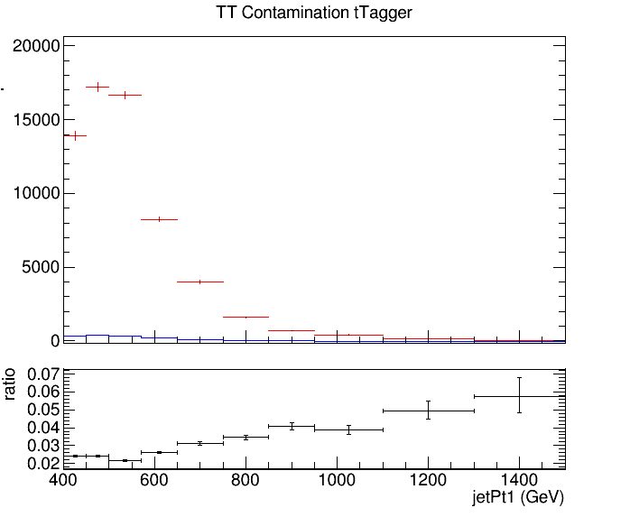
CR Contamination ’16,’17,’18 jetPt1
Control Region QCD sample
Control Region TT sample
2016
2017
2018

Slide 15
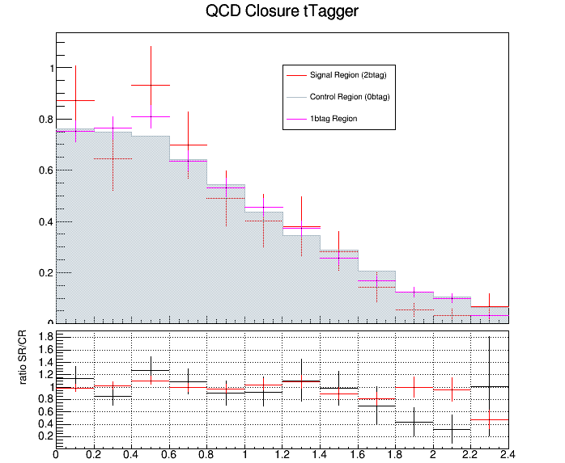
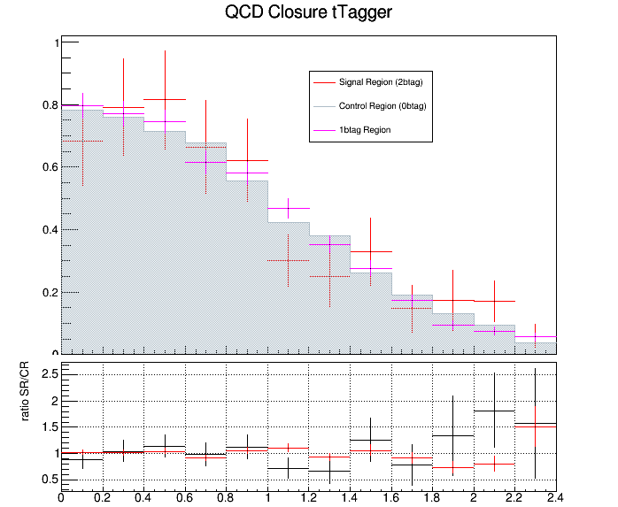
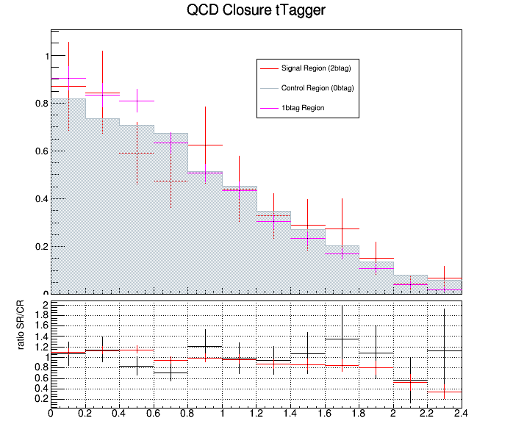
QCD Closure Tests ’16, ‘17, ’18 |jetY0|
2016
2017
2018
|jetY0|
|jetY0|
|jetY0|

Slide 16
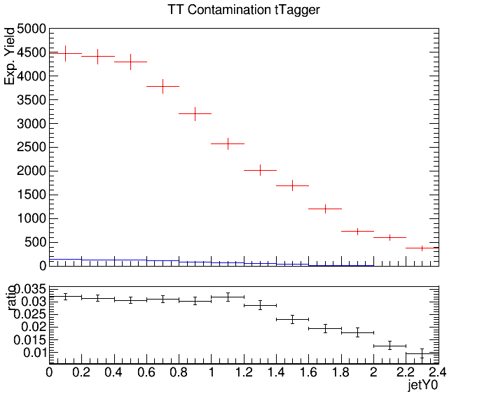
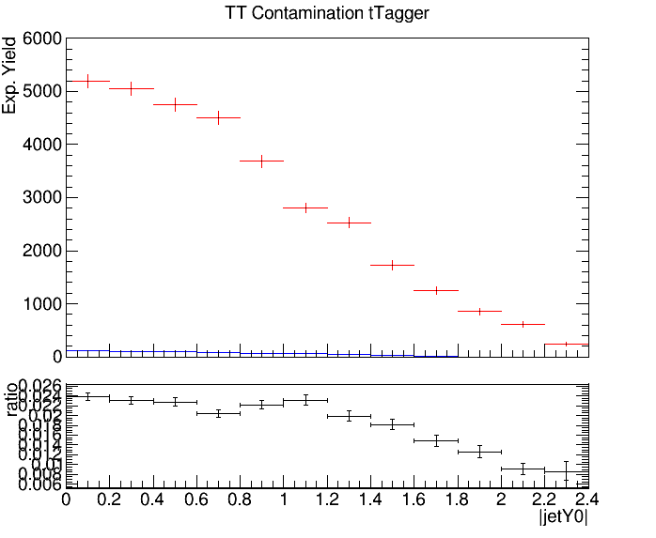
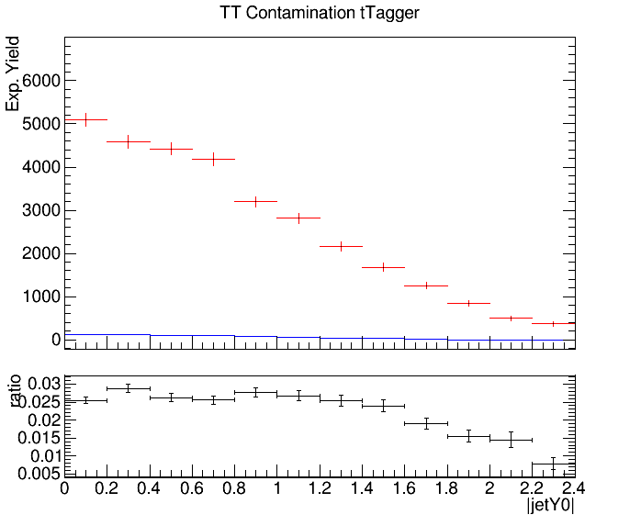
CR Contamination ’16,’17,’18 |jetY0|
Control Region QCD sample
Control Region TT sample
2016
2017
2018

Slide 17
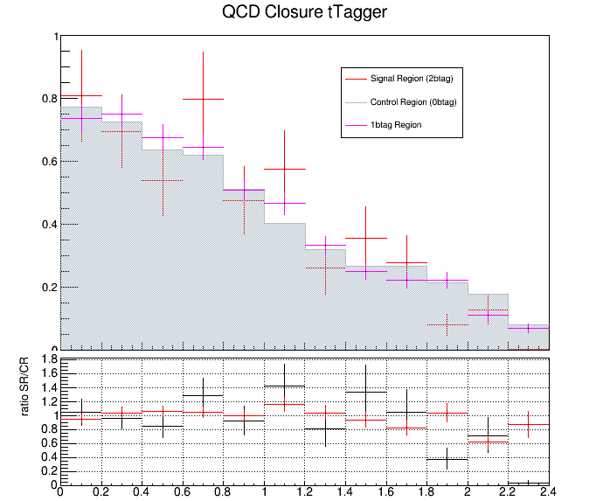
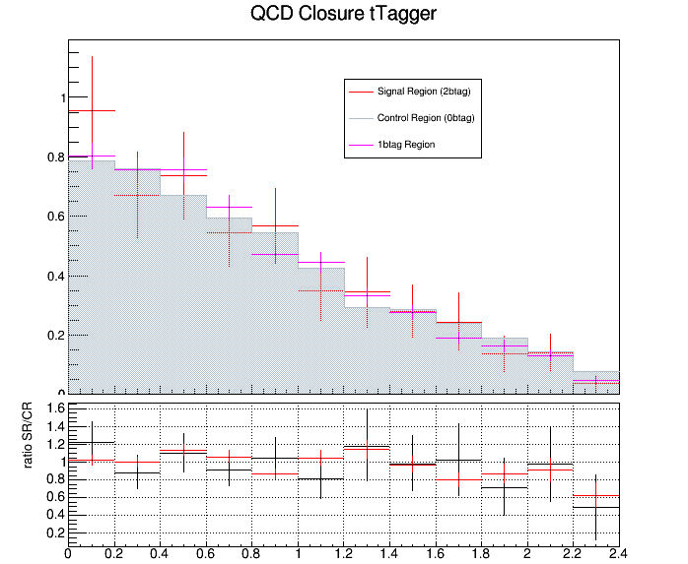
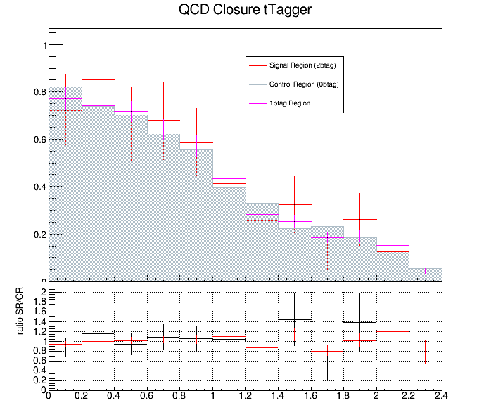
QCD Closure Tests ’16, ‘17, ’18 |jetY1|
2016
2017
2018
|jetY1|
|jetY1|
|jetY1|

Slide 18
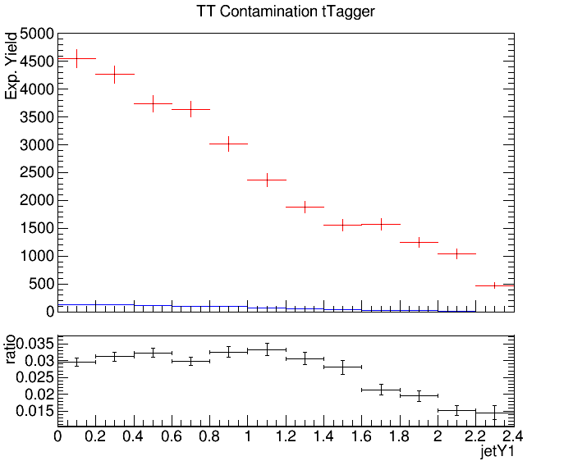
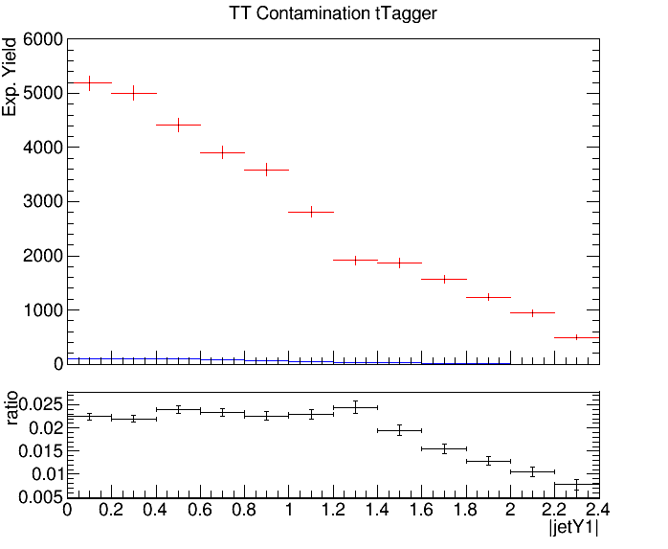
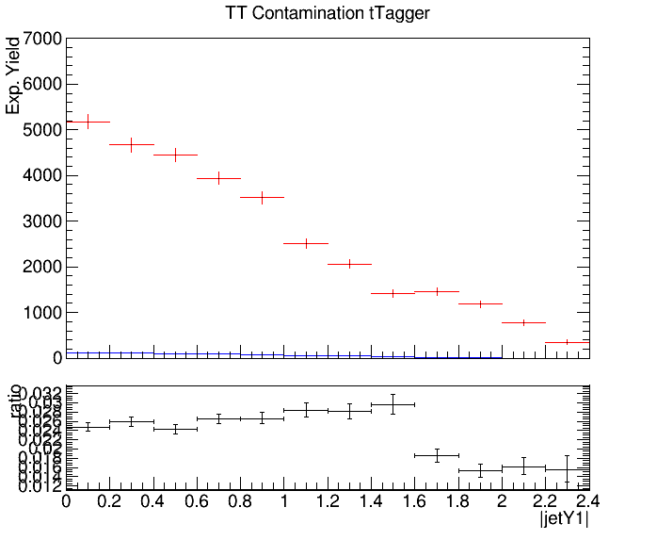
CR Contamination ’16,’17,’18 |jetY1|
Control Region QCD sample
Control Region TT sample
2016
2017
2018

Slide 19
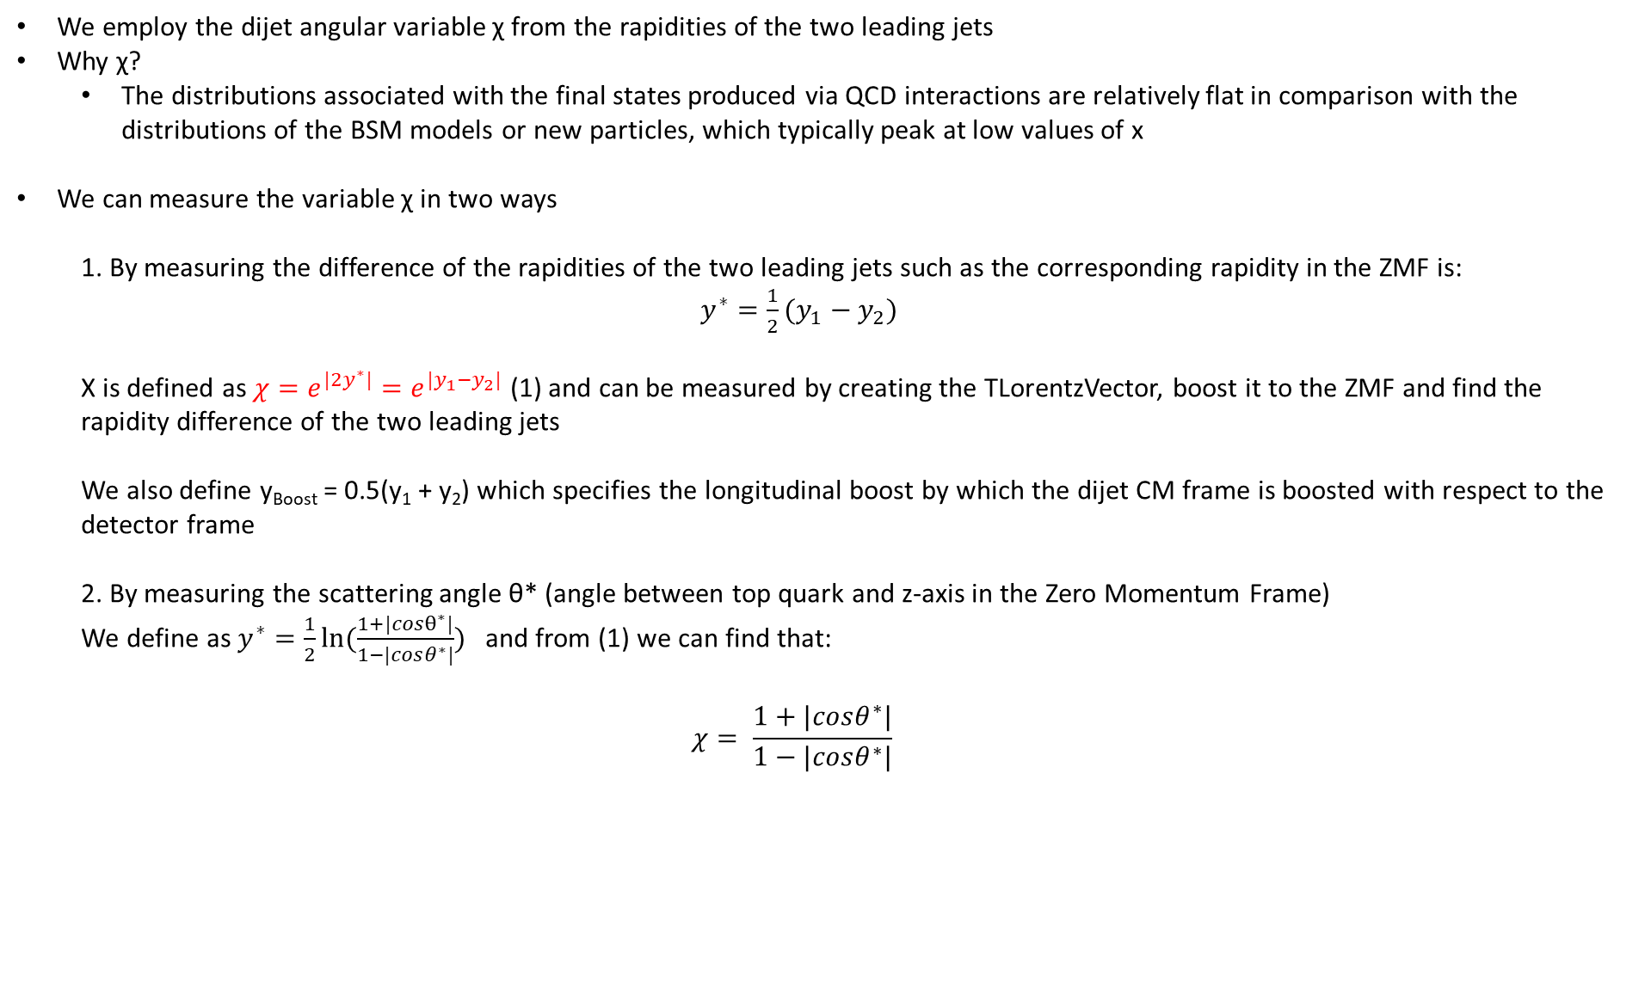
Angular Distributions
We employ the dijet angular variable χ from the rapidities of the two leading jets
Why χ?
The distributions associated with the final states produced via QCD interactions are relatively flat in comparison with the distributions of the BSM models or new particles, which typically peak at low values of x
We can measure the variable χ in two ways
1. By measuring the difference of the rapidities of the two leading jets such as the corresponding rapidity in the ZMF is: $y^{∗}=\frac{1}{2}(y_{1}−y_{2})$
Χ is defined as $χ=e^{{|2y}^{∗}|}=e^{|y_{1}−y_{2}|}$ (1) and can be measured by creating the TLorentzVector, boost it to the ZMF and find the rapidity difference of the two leading jets
We also define y_{Boost} = 0.5(y₁ + y₂) which specifies the longitudinal boost by which the dijet CM frame is boosted with respect to the detector frame
2. By measuring the scattering angle θ* (angle between top quark and z-axis in the Zero Momentum Frame)
We define as $y^{∗}=\frac{1}{2}ln⁡(\frac{1+|cosθ^{∗}|}{1−|cosθ^{∗}|})$ and from (1) we can find that:
$$χ= \frac{1+|cosθ^{∗}|}{1−|cosθ^{∗}|}$$

Slide 20
Angular Distributions
Acceptance, Efficiency for χ, |cos(θ)| distributions
Stability and purity for χ and |cos(θ)|distributions
Closure tests and TT contamination
I measure the χ using the exponential
Here you will find a comparison of 2016, 2017 and 2018 MC’s. (I only use the Mtt 1000-Inf file )
Using DeepCSV for btagging
topTagger WP:
2016: 0.1
2017: 0.0
2018: 0.1

Slide 21
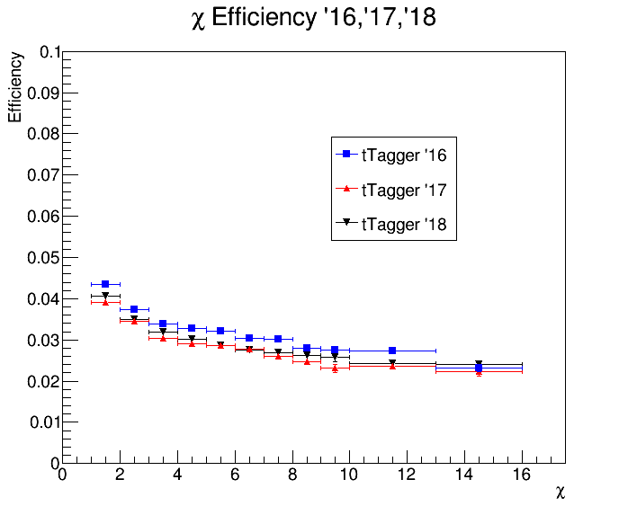
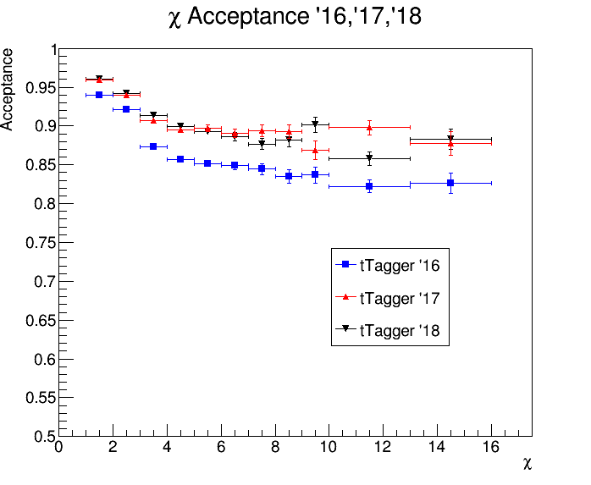
Efficiency, Acceptance for χ

Slide 22
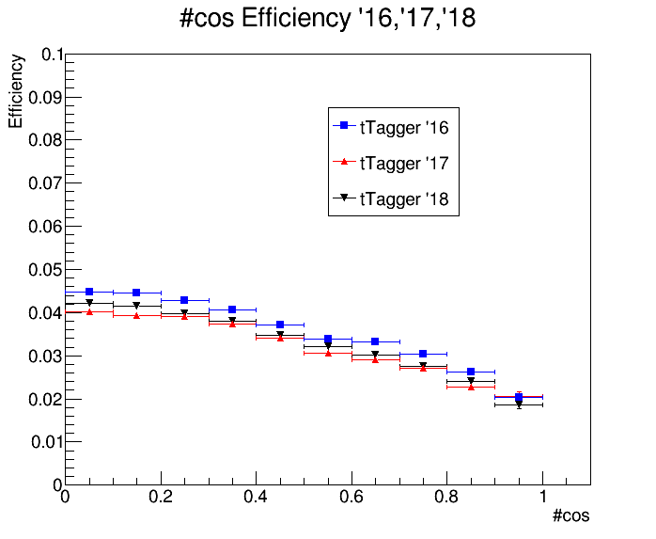
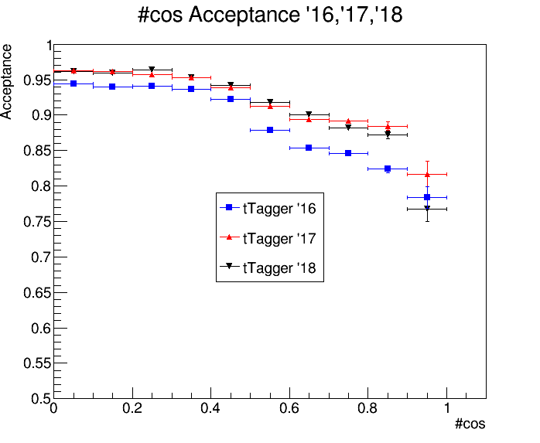

Efficiency, Acceptance for |cos(θ*)|
$$|cos\left(θ^{∗}\right)|$$
$$|cos\left(θ^{∗}\right)|$$

Slide 23



QCD Closure Tests ’16, ‘17, ’18 χ
2016
2017
2018

Slide 24



CR Contamination ’16,’17,’18 χ
Control Region QCD sample
Control Region TT sample
2016
2017
2018

Slide 25



QCD Closure Tests ’16, ‘17, ’18 |cos(θ*)|
2016
2017
2018

Slide 26



CR Contamination ’16,’17,’18 χ
Control Region QCD sample
Control Region TT sample
2016
2017
2018

